Slide 1

Data Science-
Capstone Project
Google Play App store data analysis
Submitted by
Ray Varghese
Student ID # 955473

Slide 2

Introduction
The Google Play store is a global marketplace where users activate and install applications making millions of transactions each day. This data analysis and visualization gives an insight on the application characteristics or metrics- Rating, Installs, Revenue, Size, Reviews and User Sentiments which empowers the app developers, marketing, product managers and technology investors to make data driven decisions on understanding user expectations and focus on continuous improvement.

Slide 3

Mission Statement
To analyze user reviews, app features, and performance indicators across the Google Play Store ecosystem in order to uncover meaningful insights that support product enhancement, user satisfaction, and market positioning.

Slide 4

Objectives
App Volume Analysis: Understand the distribution and availability of apps on the Google Play Store based on their characteristics.
Which app categories and genres have the highest number of available apps?
What proportion of apps are free versus paid across different categories?
How are apps distributed by content rating (e.g., Everyone, Teen, Mature)?
App Size, Price, and Revenue Metrics: Analyze the financial and structural aspects of apps to identify pricing trends and potential revenue patterns.
What is the average price and size of paid apps across different genres?
Which categories generate the highest estimated revenue from paid apps?
Is there a relationship between app size and price?
App Installation and User Rating Behavior: Assess how users interact with apps based on installation trends and user ratings.
Which categories and genres receive the highest number of installs?
How do average user ratings vary by app category or type (free vs paid)?
Is there a correlation between the number of installs and average user ratings?
User Sentiment Analysis: Evaluate user reviews to identify overall satisfaction and concerns expressed by users.
What is the overall sentiment distribution of user reviews (positive, neutral, negative)?
Which app categories have the highest proportion of positive or negative reviews?
What are the most common themes or keywords in negative reviews?

Slide 5
Data Source
Data sets
Googleplaystore.csv
https://www.kaggle.com/datasets/lava18/google-play-store-apps
Googleplaystore_user_reviews.csv
https://www.kaggle.com/datasets/prakharrathi25/google-play-store-reviews

Slide 6
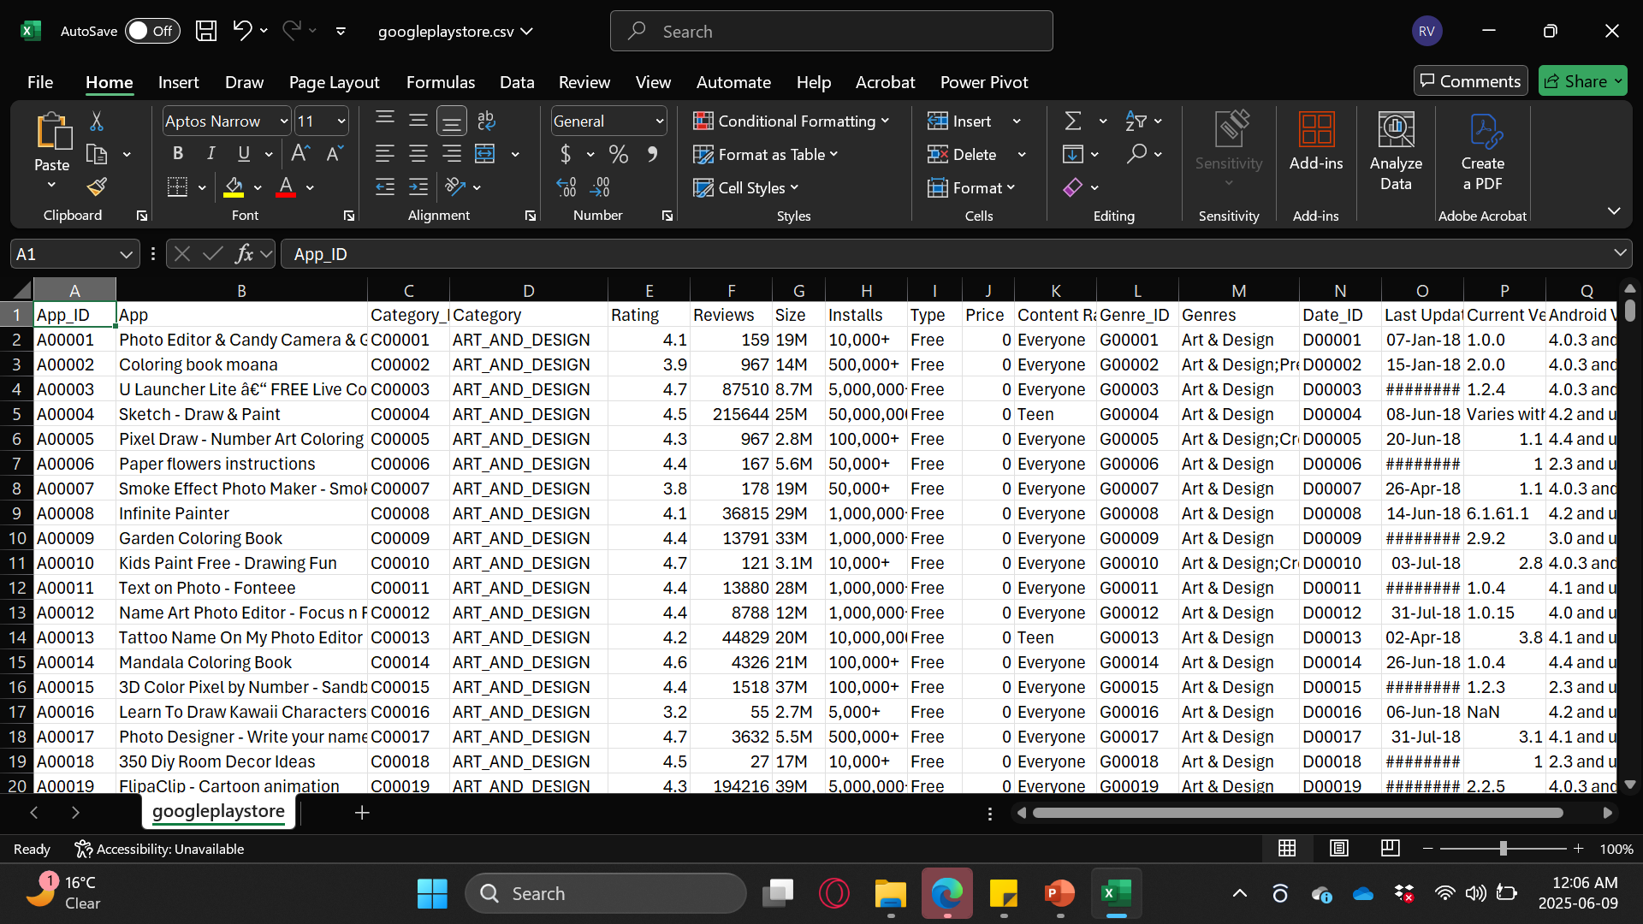
Google Play Store App data

Slide 7
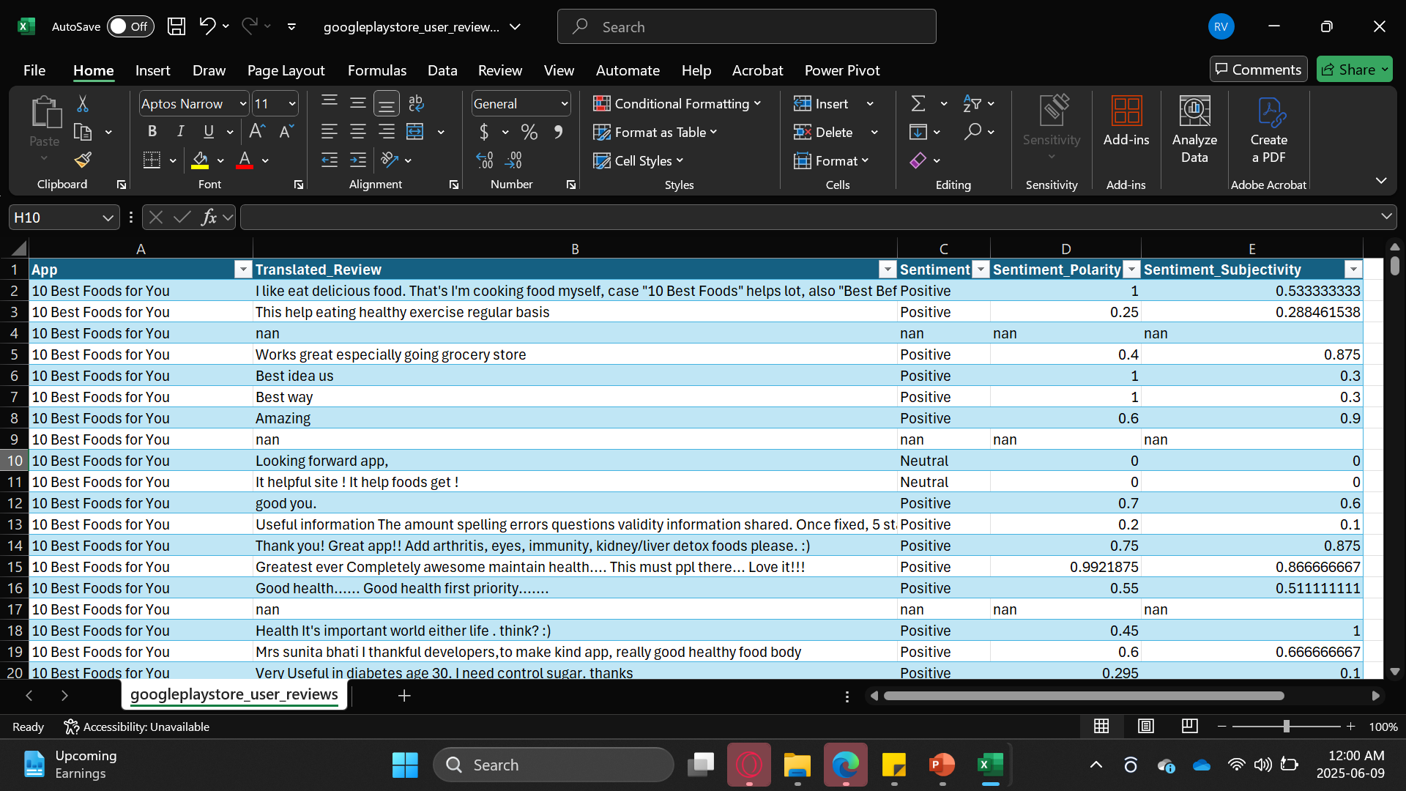
Google Play store App User reviews.csv

Slide 8
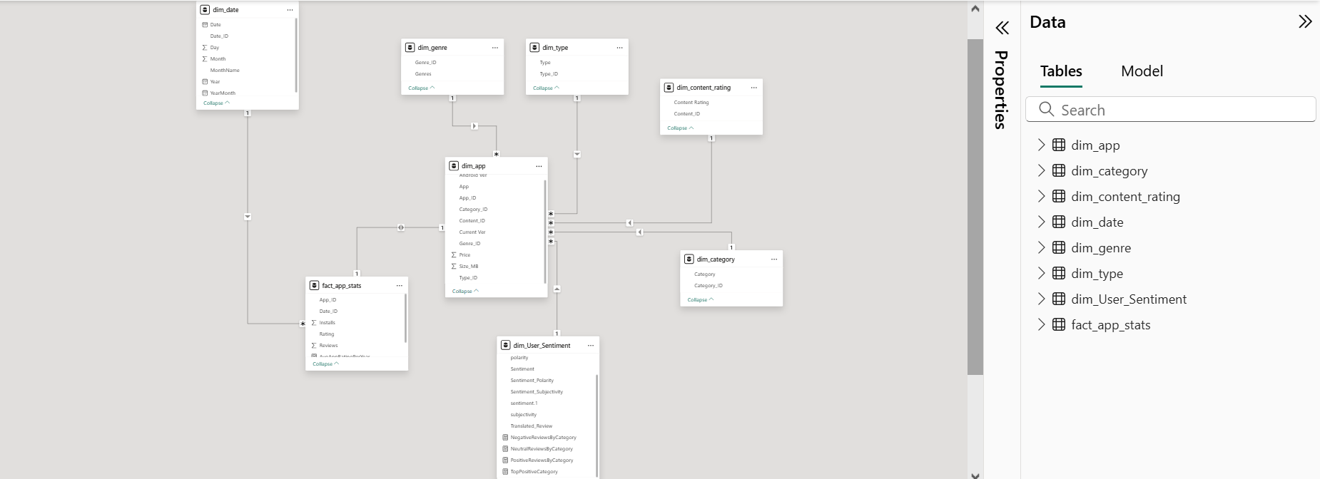
Entity Relationship Diagram- Data Model

Slide 9
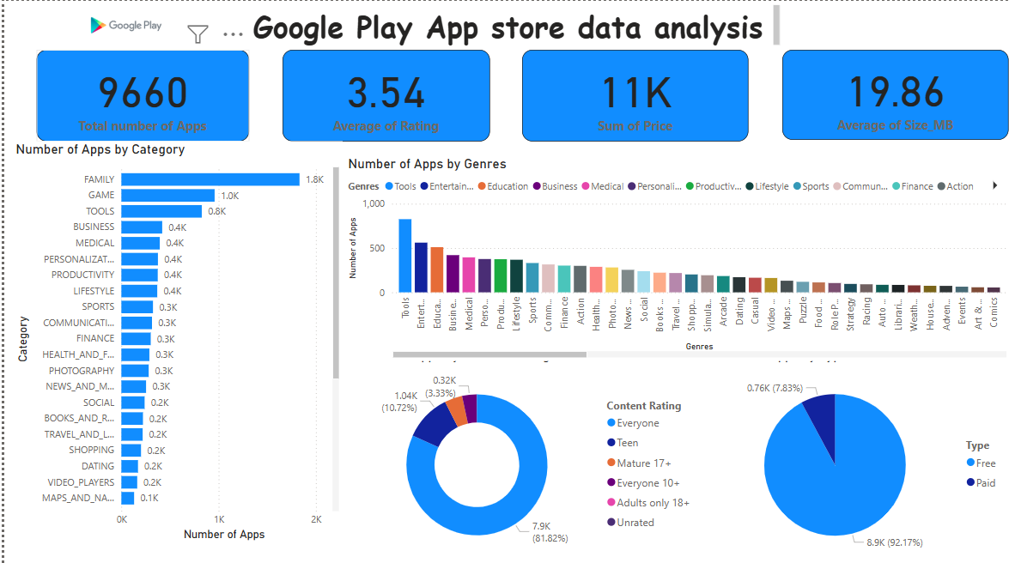

Slide 10
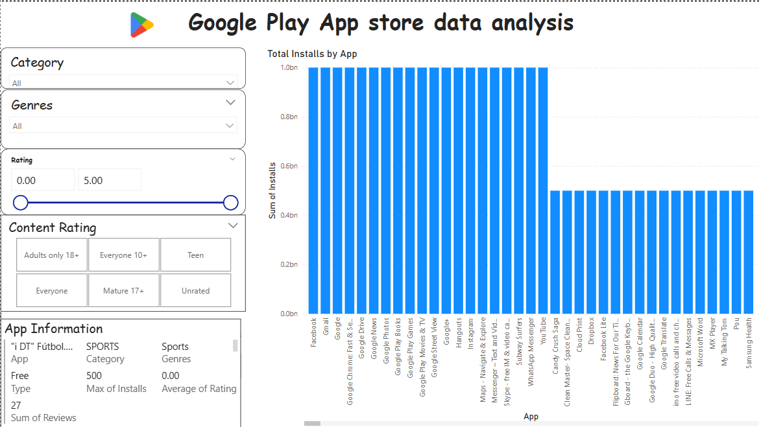

Slide 11
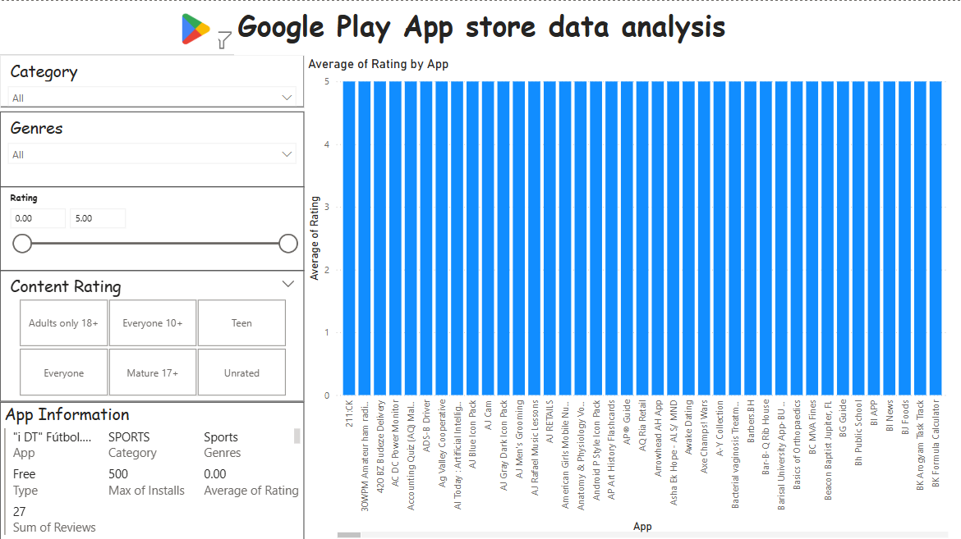

Slide 12
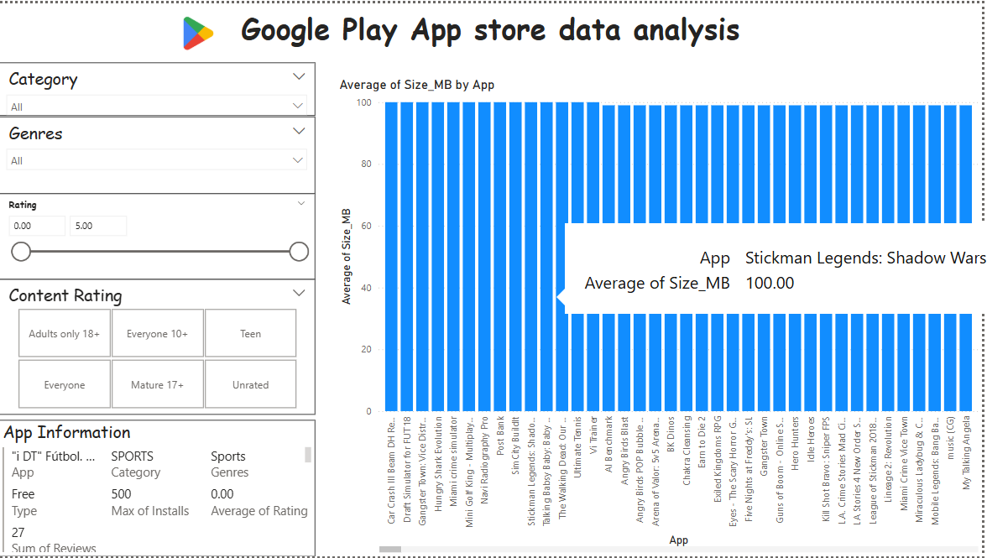

Slide 13
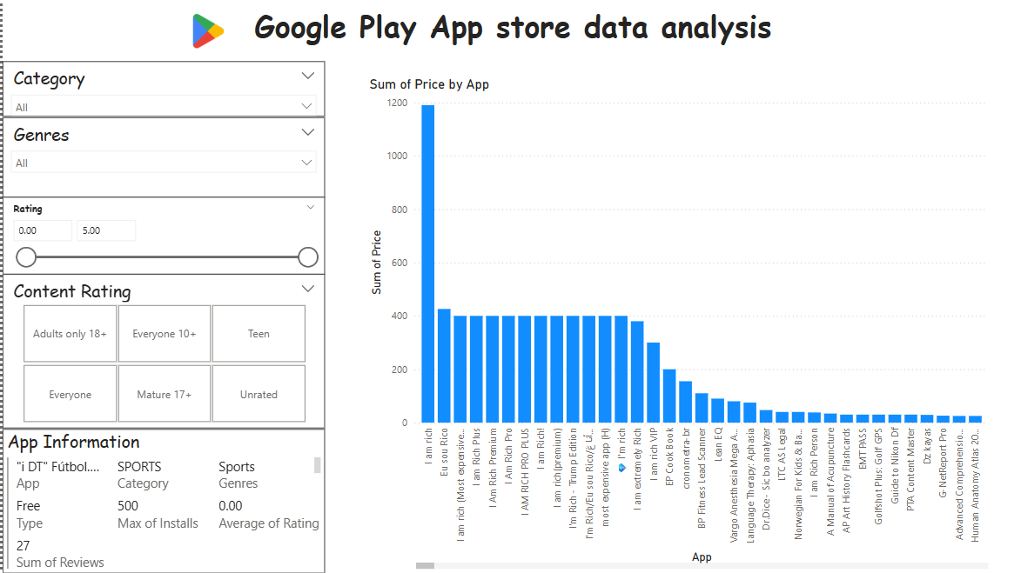

Slide 14
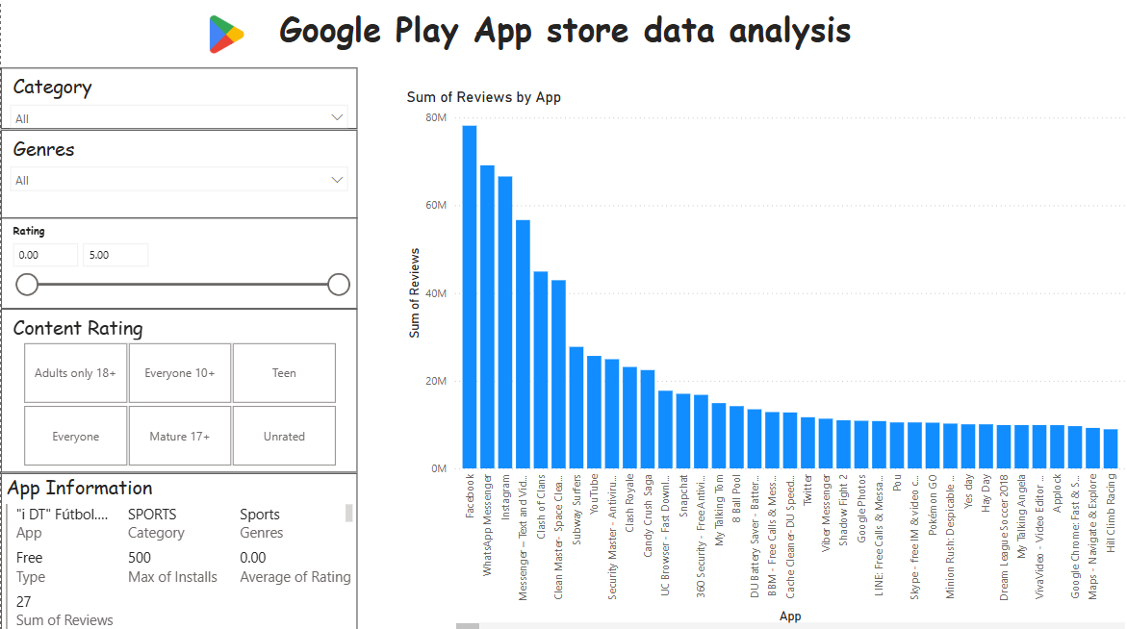

Slide 15
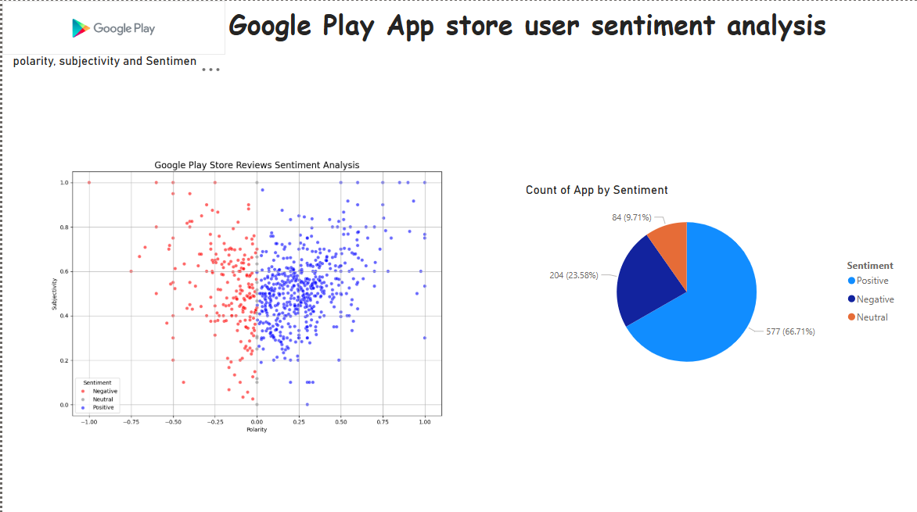

Slide 16
DAX Formulas
NegativeReviewsByCategory =
CALCULATE(
COUNTROWS(dim_User_Sentiment),
dim_User_Sentiment[Sentiment] = "Negative",
ALLEXCEPT(dim_category, dim_category[Category]))
--------------------------------------------------------------------------------
PositiveReviewsByCategory =
CALCULATE(
COUNTROWS(dim_User_Sentiment),
dim_User_Sentiment[Sentiment] = "Positive",
ALLEXCEPT(dim_category, dim_category[Category]))
------------------------------------------------------------------------------
TopPositiveCategory =
CALCULATE(
COUNTROWS(dim_User_Sentiment),
dim_User_Sentiment[Sentiment] = "Positive")
TotalInstallsPerYear =
CALCULATE(
SUM(fact_app_stats[Installs]),
ALLEXCEPT(dim_date, dim_date[Year]))
-------------------------------------------------------------------------------------------------------------
AvgAppRatingPerYear =
CALCULATE(
AVERAGE(fact_app_stats[Rating]),
ALLEXCEPT(dim_date, dim_date[Year]))
-------------------------------------------------------------------------------------------------------------

Slide 17
Conclusion- Insights Summary
This analysis uncovers key patterns in user sentiment and app behavior across the Google Play Store:
Top App Categories: Games, Family, and Tools dominate the store by volume, indicating strong developer activity and user engagement.
Leading Genres: Tools, Entertainment, and Education emerge as the most prevalent genres, pointing to a wide functional appeal across users.
Installation Trends: Categories like Social, Communication, and Tools lead in total installs, reflecting high daily utility and user dependence.
Ratings and App Size: Family and Games categories boast the highest average ratings and app sizes, suggesting content-rich experiences tailored for user engagement.
Price Outlier: The app ‘I AM RICH’ stands out as the most expensive app on the store, exemplifying niche pricing strategies.
Top Reviewed Categories: Social, Communication, Tools, and Games gather the largest number of user reviews, reflecting both high usage and feedback volume.
Sentiment Insights: Sentiment analysis reveals that most user reviews are positive, signaling overall satisfaction with app quality and experience.
These comprehensive insights enable stakeholders to: Prioritize feature development based on user sentiment and category popularity.
Target high-performing app segments for investment or improvement.
Optimize user experience and satisfaction using data-driven decisions

Slide 18
Data Source
Power Query / Python
Star Schema
Power BI

